Slide 1

Smart College Complaints Resolution System
Members:
B. Aashish -23071A66E0
K.Sai Charan -23071A66F9
K.Tejaswi -23071A66G0
Guide:
Dr.M.Gangappa
Class:
AIML-C

Slide 2
Problem Statement
Existing college complaint management systems rely on manual processing, leading to delayed responses, inconsistent prioritization, and inefficiency in handling large volumes of student complaints.
Existing System
Complaints are reviewed and categorized manually
Urgency is decided based on human judgment
High response time for large complaint volumes
Lack of consistent prioritization
Proposed System
AI-based automatic complaint categorization
Urgency prediction using machine learning
Faster routing to the concerned department
Improved efficiency and transparency

Slide 3


Motivation for the Project
Rapid increase in student complaints makes manual processing slow and unreliable
Delayed responses reduce student trust in institutional grievance systems
Poor prioritization often causes urgent issues to be handled late
Need for an AI-based system to ensure faster, fair, and transparent resolution
Real Case Example
A hostel water supply complaint was processed late because it was treated as a routine issue, causing inconvenience to many students and highlighting the need for automatic urgency detection.

Slide 4
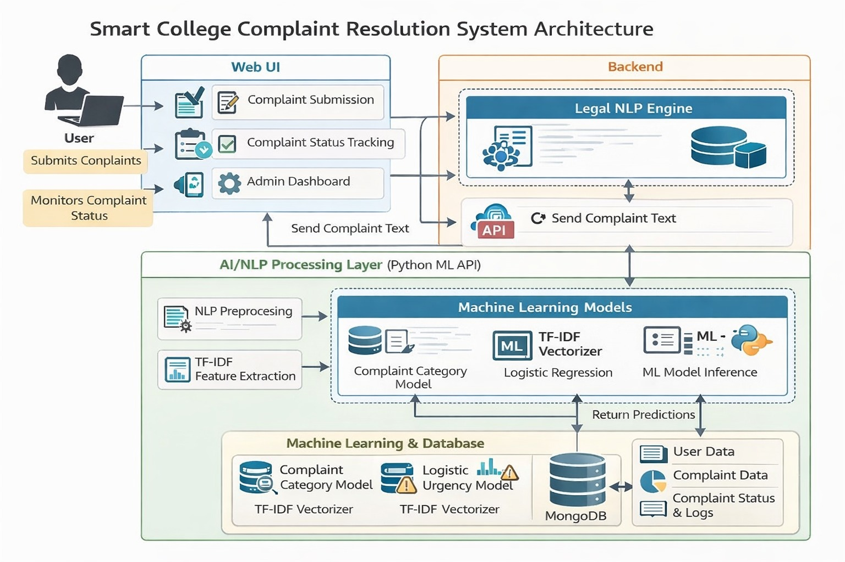

Slide 5
Technologies Used & Overall System
explanation:
Students submit complaints through an online portal
Complaint text is processed using NLP techniques
TF-IDF converts complaint text into numerical features
Machine learning model classifies complaint category and urgency
System automatically routes complaints to the concerned department
Administrators review and resolve complaints based on priority
Natural Language Processing (NLP)
TF-IDF
Logistic Regression
Python
Flask
MySQL / MongoDB

Slide 6
Module Description:
Module Name | Description | Key Functions | Inputs | Outputs
User (Student) Module | Student interface | Register, login, submit complaint, view status | User details, complaint data | Complaint status
Authentication Module | Secures system access | Login, validation, JWT handling | Credentials | Access token
Complaint Management Module | Manages complaint lifecycle | Store, assign, update complaints | Complaint details | Complaint records
Priority Prediction Module | Predicts complaint urgency | Text analysis, priority classification | Complaint text | Priority level
Admin Dashboard Module | Admin control panel | View, assign, update complaints | Complaint data | Updated status

Slide 7
Workflow / Process Flow
1.Student accesses the complaint portal.
2.Student registers or logs in using valid credentials.
3.Authentication module verifies the user.
4.Student submits a complaint by providing:
Complaint title
Complaint description
Optional image
5.Complaint management module stores the complaint details.
6.Complaint priority prediction module analyzes the complaint content.
7.System assigns priority level:
Low
Medium
High
8.Complaint is displayed in admin dashboard based on priority.

Slide 8
9.Admin reviews the complaint.
10.Admin updates complaint status:
Pending
In Progress
Resolved
11.Status update module saves the updated status.
12.Notification module sends updates to the student.
13.Complaint analytics module updates reports and statistics.
14.Student can track complaint status anytime.

Slide 9
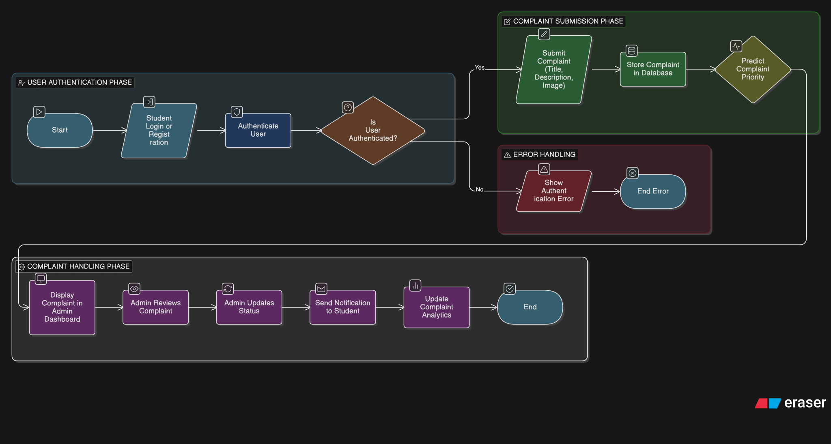

Slide 10
Input:
Student login credentials
Complaint title
Complaint description
Complaint image (optional)
Admin status update actions
Process:
User authentication and authorization.
Complaint data validation and storage.
Priority prediction using complaint content.
Sorting complaints based on urgency.
Admin review and status update.
Notification triggering.
Data analysis and report generation.
Output:
Successfully registered complaints.
Predicted complaint priority (Low / Medium / High).
Updated complaint status.
Email / WhatsApp notifications.
Complaint analytics and reports.
Improved response time and transparency.

Slide 11
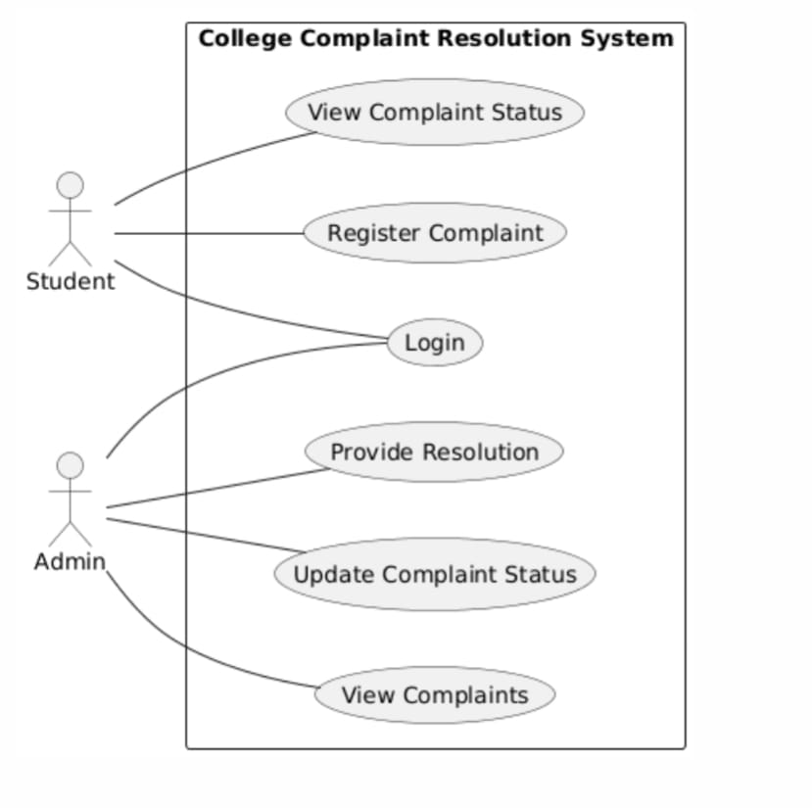
Use Case Diagram

Slide 12
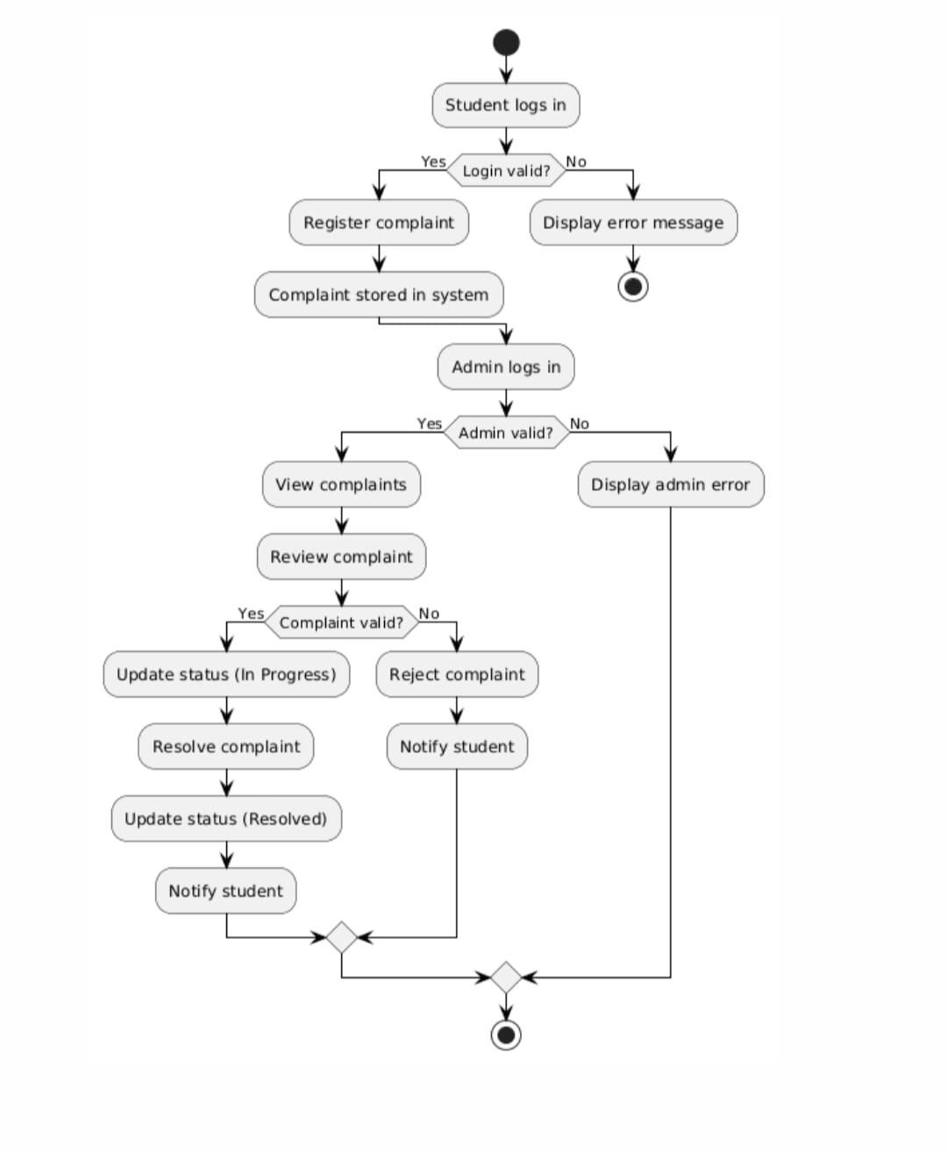
Activity Diagram

Slide 13
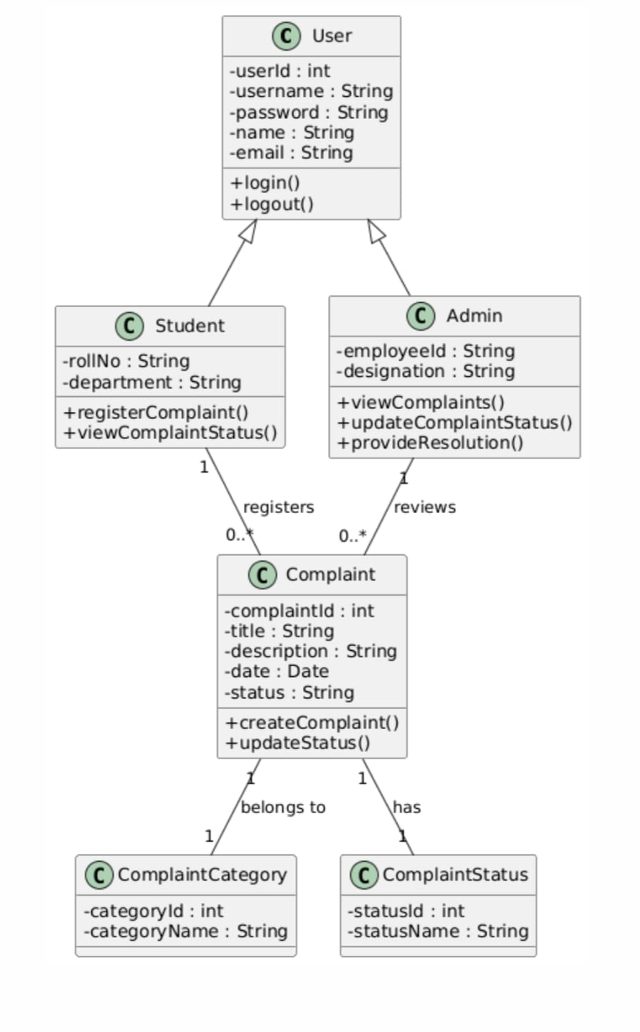
Class Diagram

Slide 14
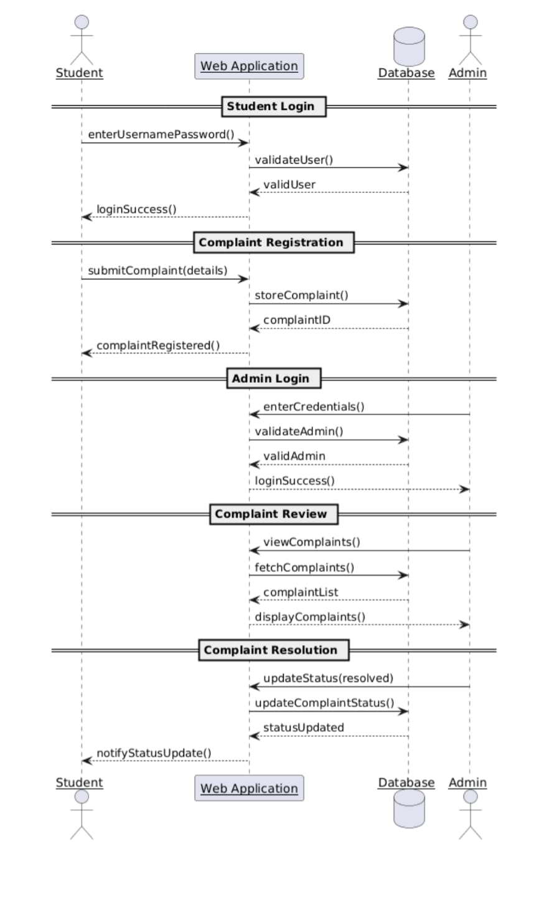
Sequence Diagram

Slide 15
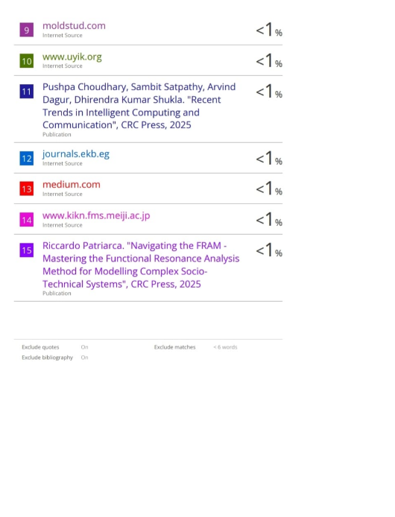
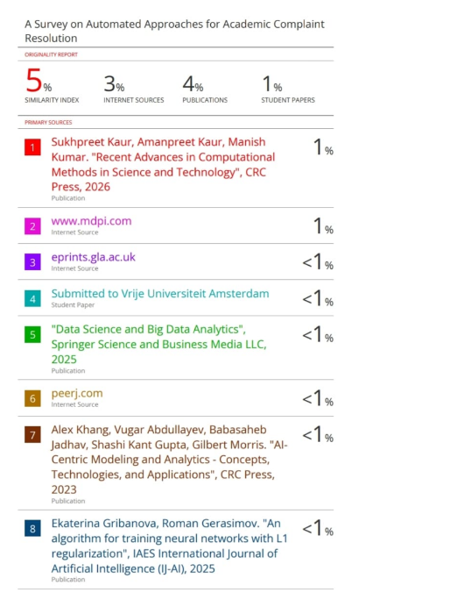
Plagiarism Report

Slide 16
Conclusion:
Implementation Plan
Develop student and admin modules with secure authentication
Train ML model using historical complaint data
Integrate priority prediction with complaint management workflow
Future Scope
Improve model accuracy using advanced deep learning techniques
Add multilingual complaint support
Deploy as a mobile application for wider accessibility
AI implementation
Design Summary
Proposed an AI-based college complaint resolution system
Uses NLP, TF-IDF, and machine learning for complaint categorization and prioritization
Automates complaint routing, tracking, and notifications

Slide 17
THANK YOU

